Slide 1
Rekha Kondeti
Graduate

Slide 2
Detection of Breast Cancer using LDA
(Task-1 ie Training=70%, Testing=30%)

Slide 3
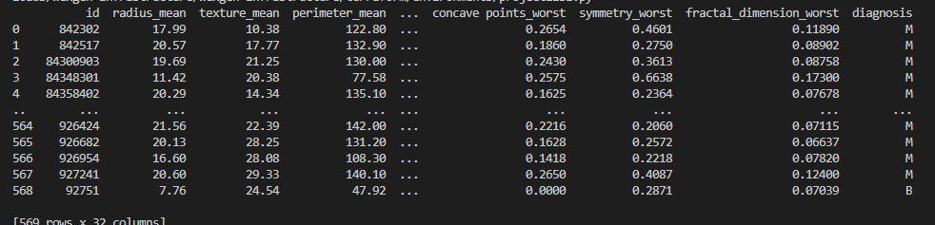
Reading data from file
df = pd.read_csv("project1data.csv")
print(df)

Slide 4
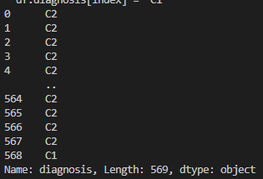
Change of column diagnosis from ‘B’ and ‘M’ to Class C1 and C2 respectively
for index,category in enumerate(df.diagnosis):
if df.diagnosis[index]== 'B’ :
df.diagnosis[index] = 'C1’
else:
df.diagnosis[index] = 'C2'
print(df.diagnosis)

Slide 5

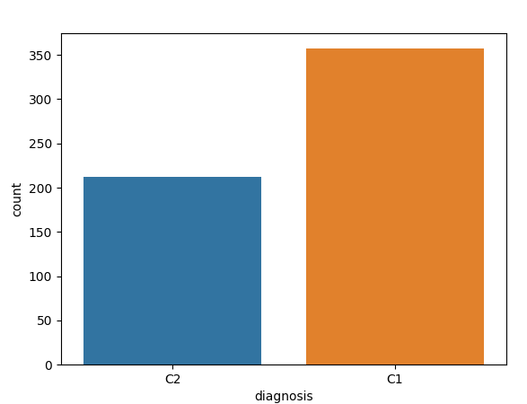
Number of C1 and C2 classes along with pic
print(df['diagnosis'].value_counts())
sns.countplot(df['diagnosis'],label="Count")
plt.show()

Slide 6
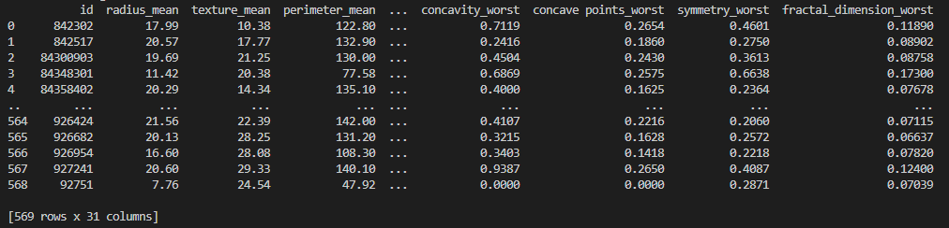
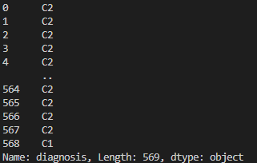
Loading P as features and T as target
p=df.iloc[0:569, 0:31]
print(p)
T=df.loc[0:569, 'diagnosis']
print(T)

Slide 7
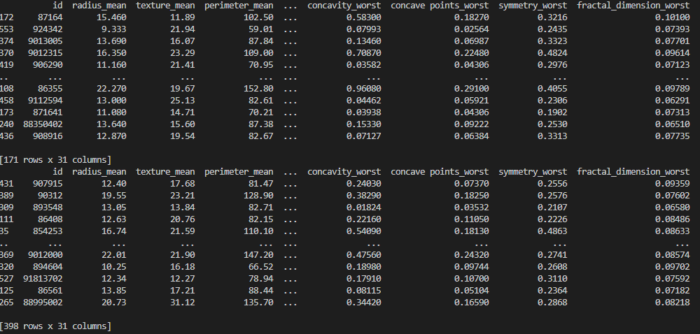
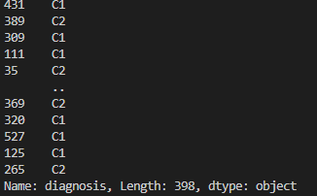
Splitting of data into training and testing of ratio 70% and 30%
x_train, x_test, y_train, y_test = train_test_split(p, T, test_size = 0.3, random_state=10)
print(x_test)
print(x_train)
print(y_train)

Slide 8
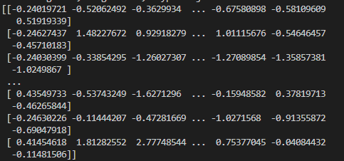
Feature Scaling of values
from sklearn.preprocessing import StandardScaler
sc = StandardScaler()
x_train = sc.fit_transform(x_train)
x_test = sc.transform(x_test)
print(x_train)

Slide 9
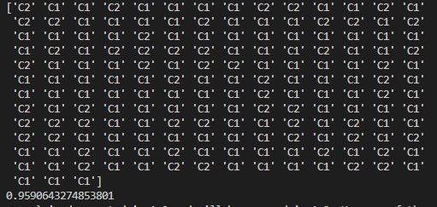
Applying LDA on data
from sklearn.discriminant_analysis import LinearDiscriminantAnalysis
model = LinearDiscriminantAnalysis()
model.fit(x_train,y_train)
print(model.predict(x_test))
print(model.score(x_test,y_test))
Model Accuracy is 95.9% as shown in pic

Slide 10
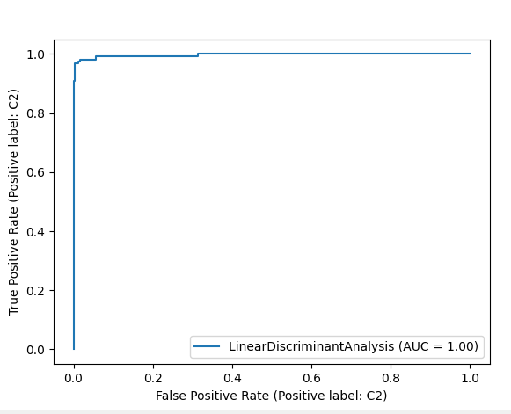
Roc Curve for training data
from sklearn.metrics import plot_roc_curve
roc_lda = plot_roc_curve(model, x_train, y_train)
plt.show()

Slide 11
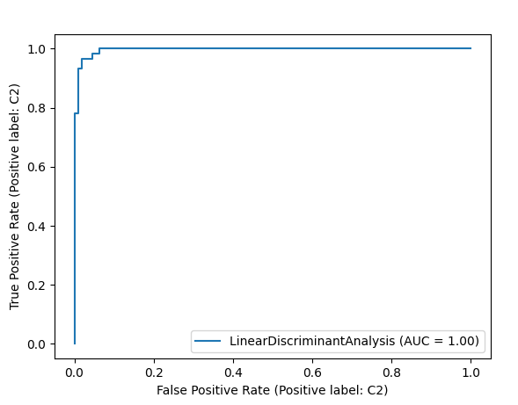
Roc Curve for testing data
from sklearn.metrics import plot_roc_curve
roc_lda = plot_roc_curve(model, x_test, y_test)
plt.show()

Slide 12

Confusion matrix of training and testing data
from sklearn.metrics import confusion_matrix
y_pred_train = model.predict(x_train)
cm_train = confusion_matrix(y_train, y_pred_train)
print(cm_train)
y_pred_test = model.predict(x_test)
cm_test = confusion_matrix(, y_test, y_pred_test)
print(cm_test)

Slide 13
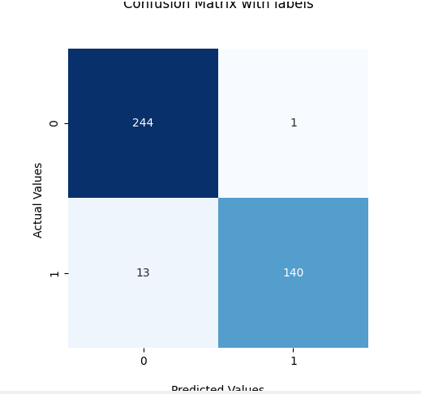
Classification matrix of Training data
from sklearn.metrics import plot_confusion_matrix
matrix_confusion = confusion_matrix(y_train, y_pred_train)
ax = sns.heatmap(matrix_confusion, square=True, annot=True, cmap='Blues', fmt='d', cbar=False)
ax.set_title('Confusion Matrix with labels\n\n')
ax.set_xlabel('\nPredicted Values')
ax.set_ylabel('Actual Values ')
plt.show()

Slide 14
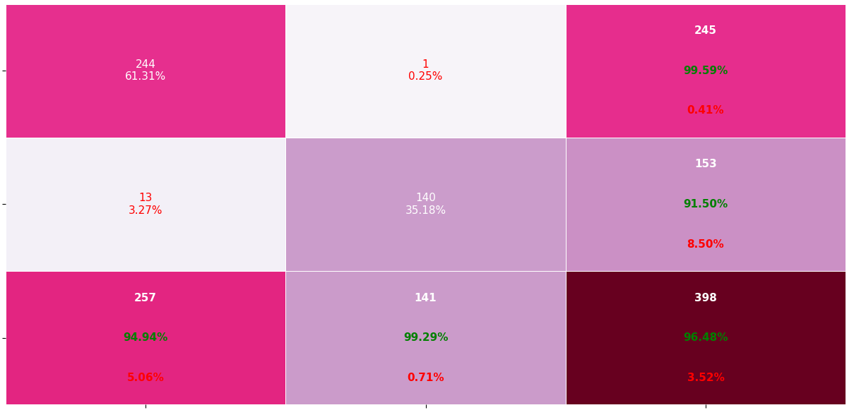
Cont…
from pretty_confusion_matrix import pp_matrix_from_data
pp_matrix_from_data(y_pred_train, y_train, cmap='PuRd')
plt.show()

Slide 15
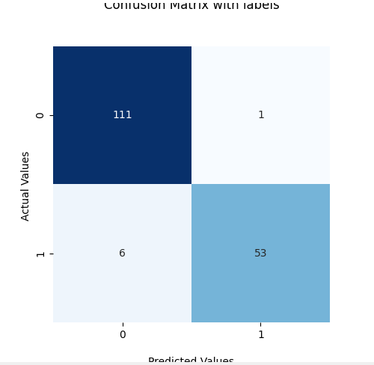
Classification matrix of Testing data
from sklearn.metrics import plot_confusion_matrix
matrix_confusion = confusion_matrix(y_test, y_pred_test)
ax = sns.heatmap(matrix_confusion, square=True, annot=True, cmap='Blues', fmt='d', cbar=False)
ax.set_title('Confusion Matrix with labels\n\n')
ax.set_xlabel('\nPredicted Values')
ax.set_ylabel('Actual Values ')
plt.show()

Slide 16
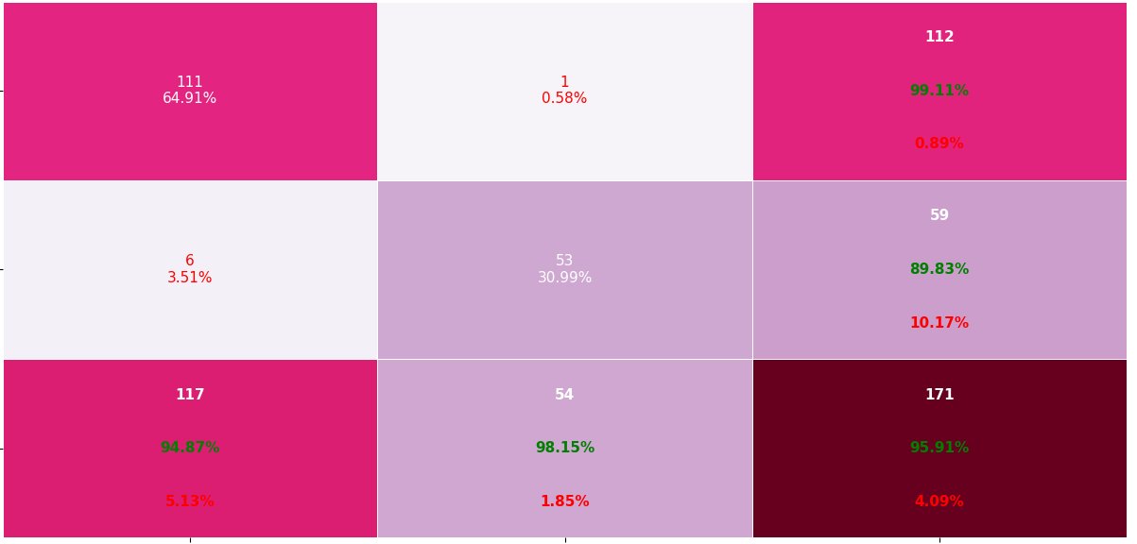
from pretty_confusion_matrix import pp_matrix_from_data
pp_matrix_from_data(y_pred_test ,y_test,cmap= 'PuRd')
plt.show()

Slide 17
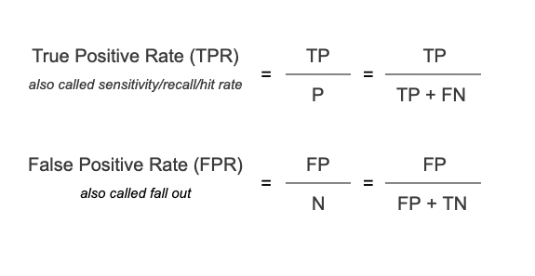
Formulas:
All positives which are correctly classified are TPR = 100%
All negatives which are miss-classified are FPR = 100%

Slide 18
Observations and Conclusion from Task 1
From Classification matrix , training and testing data respectively are:
TN =244,111
FN=1,1
FP=13,6
TP=140,53
Using FPR on x-axis and TPR on Y-axis ,Roc is plotted. It gives the values for each threshold . From the curve ROC of training and testing ,we can observe that AUC(Area Under Curve ) is highest As for the testing AUC is highest, performance is good

Slide 19
Detection of Breast Cancer using LDA
(Task-2 ie Training=40%, Testing=60%)

Slide 20
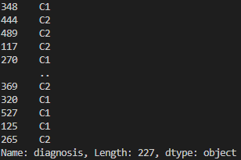
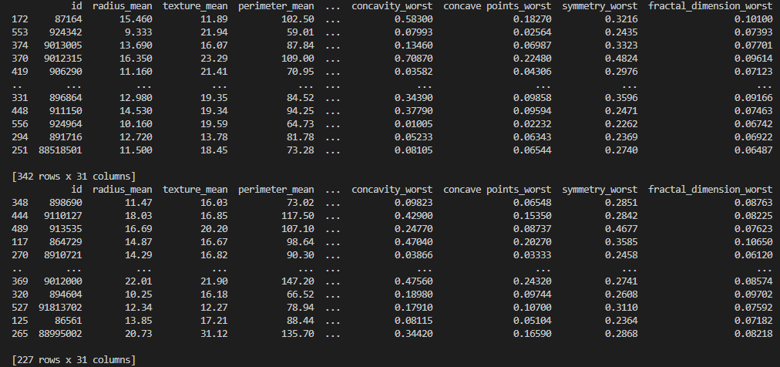
Splitting of data into training and testing of ratio 40% and 60%
x_train, x_test, y_train, y_test = train_test_split(p, T, test_size = 0.6, random_state=10)
print(x_test)
print(x_train)
print(y_train)

Slide 21
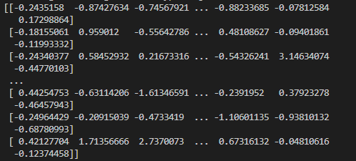
Feature Scaling of values
from sklearn.preprocessing import StandardScaler
sc = StandardScaler()
x_train = sc.fit_transform(x_train)
x_test = sc.transform(x_test)
print(x_train)

Slide 22
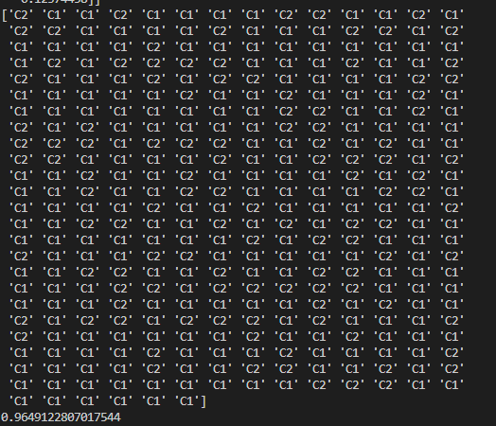
Applying LDA on data
from sklearn.discriminant_analysis import LinearDiscriminantAnalysis
model = LinearDiscriminantAnalysis()
model.fit(x_train,y_train)
print(model.predict(x_test))
print(model.score(x_test,y_test))
Model Accuracy is 96.4% as shown in pic

Slide 23
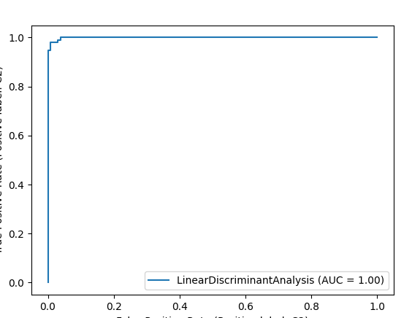
Roc Curve for training data
from sklearn.metrics import plot_roc_curve
roc_lda = plot_roc_curve(model, x_train, y_train)
plt.show()

Slide 24
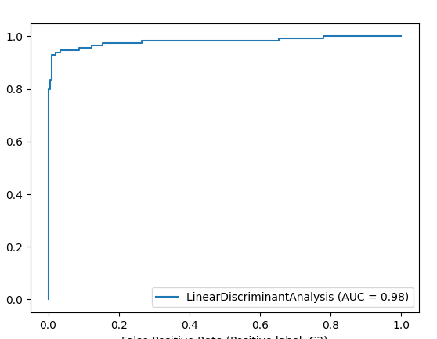
Roc Curve for testing data
from sklearn.metrics import plot_roc_curve
roc_lda = plot_roc_curve(model, x_test, y_test)
plt.show()

Slide 25

Confusion matrix of training and testing data
from sklearn.metrics import confusion_matrix
y_pred_train = model.predict(x_train)
cm_train = confusion_matrix(y_train, y_pred_train)
print(cm_train)
y_pred_test = model.predict(x_test)
cm_test = confusion_matrix(y_test, y_pred_test )
print(cm_test)

Slide 26
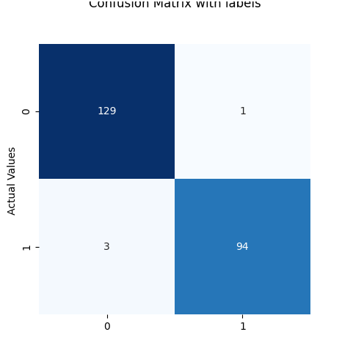
Classification matrix of Training data
from sklearn.metrics import plot_confusion_matrix
matrix_confusion = confusion_matrix(y_train, y_pred_train)
ax = sns.heatmap(matrix_confusion, square=True, annot=True, cmap='Blues', fmt='d', cbar=False)
ax.set_title('Confusion Matrix with labels\n\n')
ax.set_xlabel('\nPredicted Values')
ax.set_ylabel('Actual Values ')
plt.show()

Slide 27
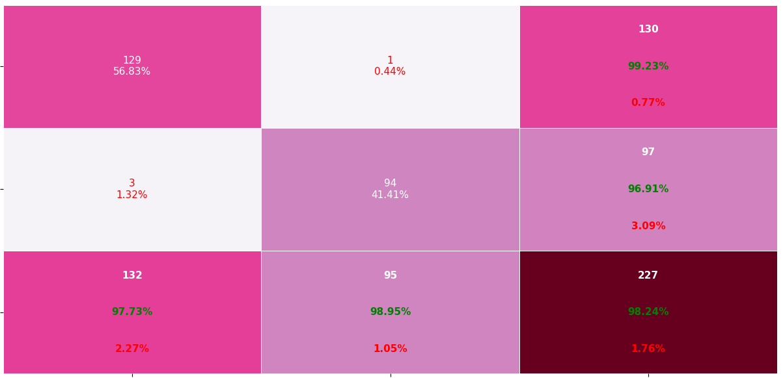
Cont…
from pretty_confusion_matrix import pp_matrix_from_data
pp_matrix_from_data(y_pred_train, y_train, cmap='PuRd')
plt.show()

Slide 28
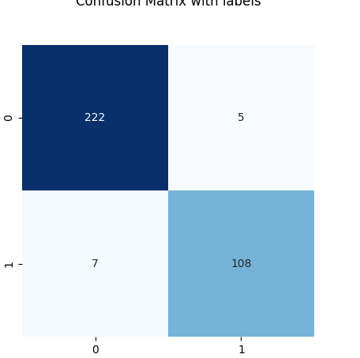
Classification matrix of Testing data
from sklearn.metrics import plot_confusion_matrix
matrix_confusion = confusion_matrix(y_test, y_pred_test)
ax = sns.heatmap(matrix_confusion, square=True, annot=True, cmap='Blues', fmt='d', cbar=False)
ax.set_title('Confusion Matrix with labels\n\n')
ax.set_xlabel('\nPredicted Values')
ax.set_ylabel('Actual Values ')
plt.show()

Slide 29
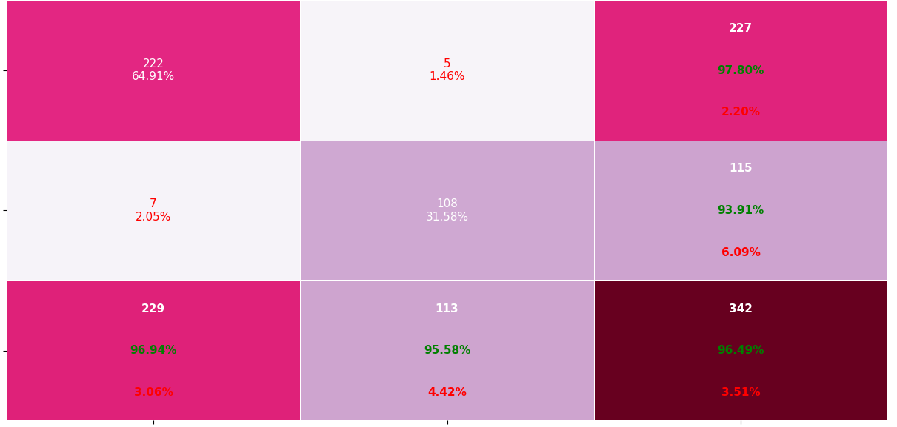
Cont…
from pretty_confusion_matrix import pp_matrix_from_data
pp_matrix_from_data(y_pred_test ,y_test,cmap= 'PuRd')
plt.show()

Slide 30
Observations and Conclusions from both the tasks
From Classification matrix , we can say that values of Training data and testing respectively are:
TN =129, 222
FN=1, 5
FP=3, 7
TP=94, 108
Using FPR on x-axis and TPR on Y-axis ,Roc is plotted. It gives the values for each threshold . From the curve ROC of training and testing ,we can observe how the graph shows values
AUC of testing is 0.98 which is less when compared to AUC testing of task1.Hence from the 2 tasks, if we have high training data when compared to testing data we can gain testing good performance .

